Slide 1
Computer generation of designs for two-phase experiments with applications to multiplex experiments in proteomics Ph.D. Thesis
Kevin Chang
2 Nov 2017
School of Biological Sciences

Slide 2
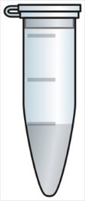
Two-phase experiments (McIntyre, 1955)
Phase 1
Apply treatments
Phase 2
Quantification
High-throughput
biotechnologies
Cannot directly measure responses
Notes:
When a sample, collected from an experiment, cannot be measured directly, an extra stage of an experiment is needed to make this measurement.
For example, if we test which proteins are different in abundance between healthy and diseased rats, once the rats have been perturbed, we cannot measure the protein abundance directly from these animals. Further experimentation is needed to dissect the tissue of the interest, i.e. heart or pancreas, and then extract the proteins, so that we can use one of the high-throughput bio-technologies to measure these proteins. Hence, we have to design for the sample perturbation, and then we have another design for using the high-throughput bio-technologies.
The important thing here is that we need two phases of experiment to measure the thing of interest, namely protein abundance. The problem now is that both phases introduce different sources of variation and this has fundamental implications for how the data which are collected should be analysed.

Slide 3
Overview
Finding optimal design for Phase 2 experiment
Example: when Phase 1 experiment arranged in randomised complete block design
An objective function I developed for this purpose
Assessing properties of designs for two-phase experiments:
Theoretical analysis of variance (ANOVA) table
Automation by my R package infoDecompuTE
While the motivating examples come from proteomics experiments, the methods presented apply more generally across a wide range of biological, and other, experiments.
Notes:
Work has been done, but not at the level of the non-specialist.
Thus, a fundamental component of this thesis is the development methodologies for the computer generation of designs for two-phase experiments. A combination of theory, to derive multi-criterion objective functions, and computing, in which a modied simulated annealing algorithm is developed, are used to identify A-optimal designs for the Phase 2 when the Phase 1 experiment is arranged in either a completely randomised, a randomised complete block or a balanced incomplete block design. Optimal designs for range of design parameters for both the Phase 1 and Phase 2 experiments are catalogued in
the appendices of this thesis, as are summary tables of their properties.
Theoretical analysis of variance (ANOVA) tables, showing the decomposition of the total variability in the data space into its constituent components of known sources of variation, and their corresponding degrees of freedom, are shown to play an important role in assessing the properties of competing designs for two-phase experiments

Slide 4

Example
Which proteins differ in abundance between plants assigned one of three treatments?
Phase 1 experiment
3 treatments (a, b and c)
4 biological replicates, 12 plants in total
2 trays (blocks)
2 technical replicates, 24 subsamples
Phase 2 experiment
6 runs coupled with 4 tags
How do we design this experiment?
a
b
c
Notes:
Each treatment is replicated four times, giving 12 plants in total.

Slide 5

Example: Phase 1 Experiment
Phase 1 Experiment
3 treatments (a, b and c)
4 biological replicates, 12 plants in total (A, B, …, L)
2 trays (blocks; 1, 2)
Randomised Complete Block design (RCBD)
2 technical replicates, 24 subsamples in total
Tray 1
Tray 2
1Aa
1Da
2Ga
2Ja
1Bb
1Eb
2Hb
2Kb
1Cc
1Fc
2Ic
2Lc

Slide 6
Example: Phase 1 Experiment
Phase 1
Block structure: Tray/Plant
Treatment structure: Treatment
Theoretical ANOVA tables for one protein
Tray 1
Tray 2
1Aa
1Da
2Ga
2Ja
Variation between Trays and Plants
Differences between Treatments
1Bb
1Eb
2Hb
2Kb
1Cc
1Fc
2Ic
2Lc

Slide 7
Example: Phase 2 Experiment ignoring Phase 1
Six Mass Spec runs with 4-plex labelling system
Randomised block design
 | Tag
Run | 1 | 2 | 3 | 4
1
2
3
4
5
6
Variation between Runs , Subsamples
Differences between Tags
Notes:
So now we want to find the best way to allocate the 24 samples from the phase 1 experiment to the 6-by-4 grid of phase 2 experiment.

Slide 8
Theoretical ANOVA tables for one protein
Phase 1:
Phase 2:
Want to estimate Treatment effects in Within Runs stratum
15 df available
Variation between Runs ,Trays , Plants and Subsamples
Differences between Treatments and between Tags
Notes:
To explain what makes the design optimal, we need to use the theoretical ANOVA tables.
The theoretical ANOVA table for the Phase 1 experiment - all the treatment information is in the Between Plants Within Trays stratum.
The theoretical ANOVA table for the Phase 2 experiment - note that the Tag effect is fixed effect.
We want to have all the information for the Phase 1 experiment in the stratum where there is minimum of runs and tags information.

Slide 9
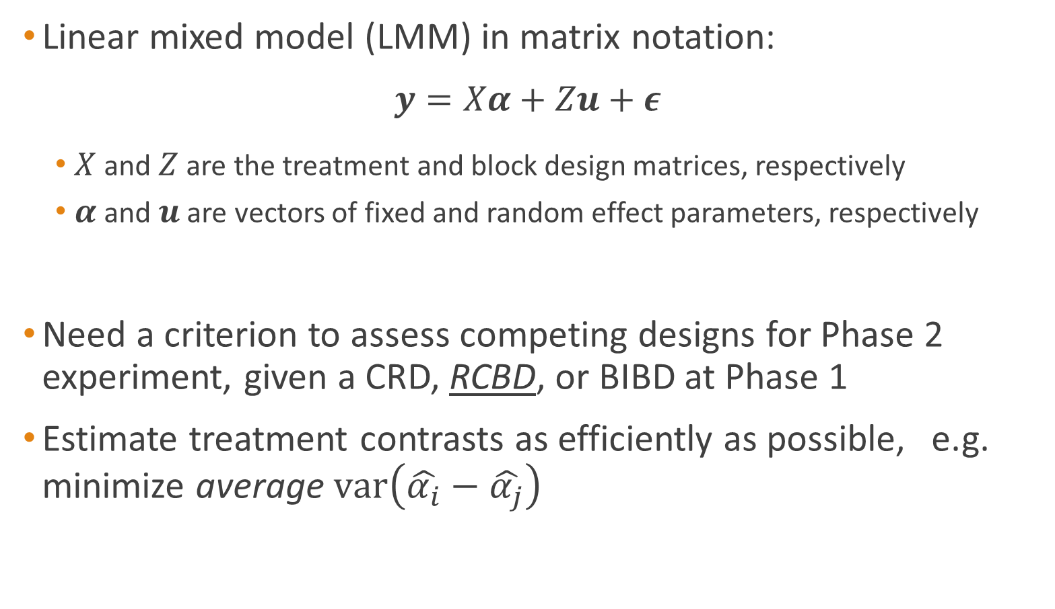
Assessing competing designs
Linear mixed model (LMM) in matrix notation:
$$y=Xα+Zu+ε$$
$X$ and $Z$ are the treatment and block design matrices, respectively
$α$ and $u$ are vectors of fixed and random effect parameters, respectively
Need a criterion to assess competing designs for Phase 2 experiment, given a CRD, RCBD, or BIBD at Phase 1
Estimate treatment contrasts as efficiently as possible, e.g. minimize average $var\left(\hat{α_{i}}−\hat{α_{j}}\right)$
Notes:
The general model in matrix notation can be written as… where X and Z are treatment and block design matrices and \tau and u denote parameters of treatment and blocks. Epsilon is a vector of measurement error.
A is information matrix.
q is vector of adjusted treatment totals.
Variance of the treatment pairwise comparison is …
For the complete block design, all the treatment information is in the Within Blocks stratum, so the diagonal elements of the A^{-} are 1/r and the off-diagonal elements of A^{-} are 0. so it becomes…
The ratio between these two values is 1 for the complete block design.

Slide 10
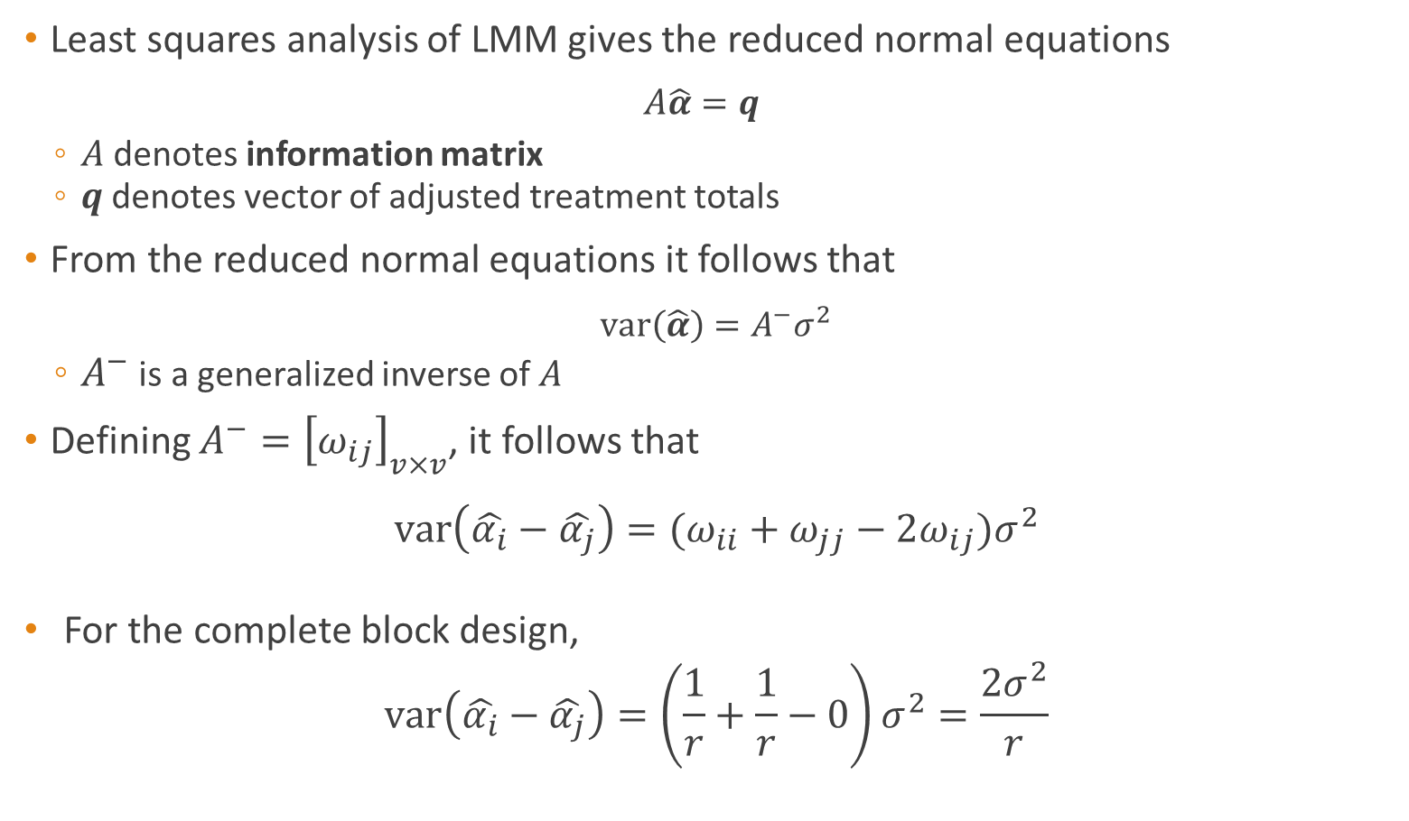
Information matrix
Least squares analysis of LMM gives the reduced normal equations
$$A\hat{α}=q$$
$A$ denotes information matrix
$q$ denotes vector of adjusted treatment totals
From the reduced normal equations it follows that
$$\text{var}\left(\hat{α}\right)=A^{−}σ^{2}$$
$A^{−}$ is a generalized inverse of $A$
Defining $A^{−}={\left[ω_{ij}\right]}_{v×v}$, it follows that
$$var\left(\hat{α_{i}}−\hat{α_{j}}\right)=(ω_{ii}+ω_{jj}−2ω_{ij})σ^{2}$$
For the complete block design,
$$var\left(\hat{α_{i}}−\hat{α_{j}}\right)=\left(\frac{1}{r}+\frac{1}{r}−0\right)σ^{2}=\frac{2σ^{2}}{r}$$
Notes:
The general model in matrix notation can be written as… where X and Z are treatment and block design matrices and \tau and u denote parameters of treatment and blocks. Epsilon is a vector of measurement error.
A is information matrix.
q is vector of adjusted treatment totals.
Variance of the treatment pairwise comparison is …
For the complete block design, all the treatment information is in the Within Blocks stratum, so the diagonal elements of the A^{-} are 1/r and the off-diagonal elements of A^{-} are 0. so it becomes…
The ratio between these two values is 1 for the complete block design.

Slide 11
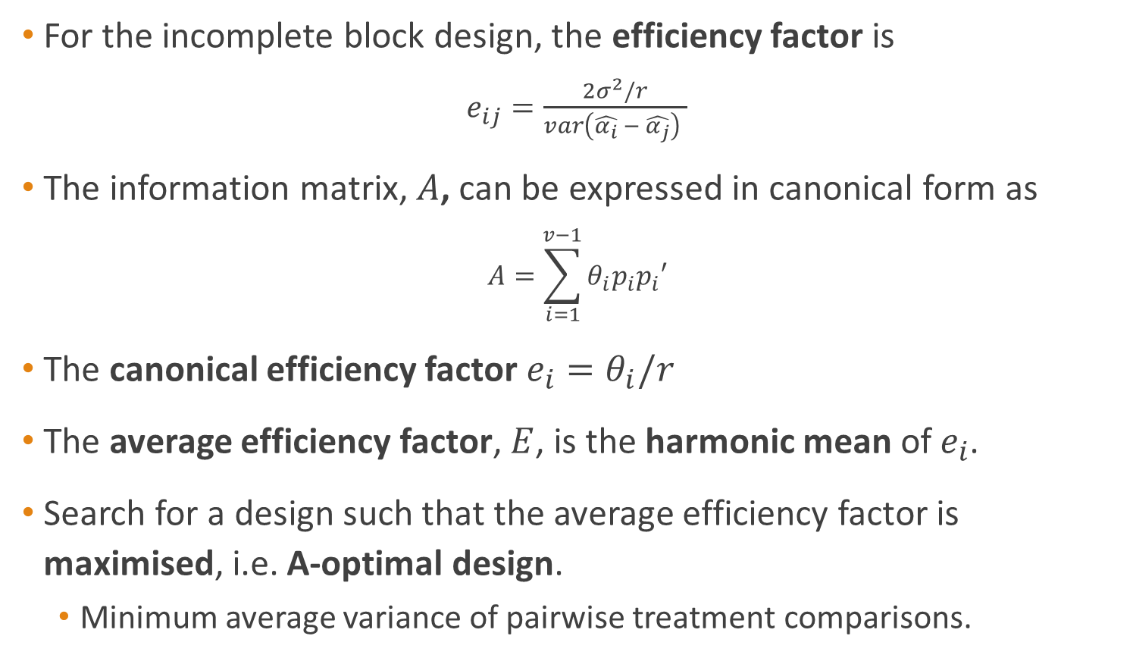
Average efficiency factor
For the incomplete block design, the efficiency factor is
$e_{ij}=\frac{2σ^{2}/r}{var\left(\hat{α_{i}} − \hat{α_{j}}\right) }$
The information matrix, $A$, can be expressed in canonical form as
$$A=\sum_{i=1}^{v−1}{θ_{i}p_{i}p_{i}′}$$
The canonical efficiency factor $e_{i}=θ_{i}/r$
The average efficiency factor, $E$, is the harmonic mean of $e_{i}$.
Search for a design such that the average efficiency factor is maximised, i.e. A-optimal design.
Minimum average variance of pairwise treatment comparisons.
Notes:
If the block design is incomplete, the ratio between these two values is not 1 anymore, as this ratio is also known as the efficiency factor for the this particular pairwise treatment comparison.
The canonical efficiency factors associated with each of the treatment contrast (eigenvectors) can be computed from the eigenvalues of the information matrix.
The average efficiency factor is the harmonic mean of the canonical efficiency factors.
Here, we search for designs that the average efficiency factor is maximised, i.e. A-optimal design. That has minimum average variance of pairwise treatment comparisons.

Slide 12
Theoretical ANOVA tables
The treatment average efficiency factor in the Between Plants Within Trays Within Runs and Tags vector subspace is maximised.
Notes:
In addition, we want tests for the treatment effects still able to be conducted. All 3 DF associated with treatment effects are still in the Between Plants Within Trays stratum and the amount of treatment information is at its maximum.

Slide 13
Theoretical ANOVA tables
The Residual DF in the Between Plants Within Trays Within Runs stratum are maximised.

Slide 14
Theoretical ANOVA tables
The DF associated with Treatment effects in the Between Plants Within Trays Within Runs stratum are intact, i.e. same as the Phase 1 experiment.
We can test for the treatment effects and also estimate the variances of the treatment effects in the Between Plants Within Trays Within Runs stratum.
Notes:
We want tests of the treatment effects to still be able to be conducted. All 2 DF associated with treatment effects are still in the Between Animal stratum and the amount of treatment information is at its maximum.

Slide 15
Developing the objective function
The first step is to locate designs
where the average efficiency factor of Phase 1 Plants in the Within Trays Within Runs and Tags vector subspace equals 1, and
the DF associated with Treatment effects in the Between Plants Within Trays Within Runs stratum are intact, i.e. same as the Phase 1 experiment.
From among the designs located in the first step, the second step uses the nested simulated annealing algorithm to find optimal designs where the Residual DF in the Between Plants Within Trays Within Runs stratum are maximised.
From among the designs found in the second step, the third step is to find the optimal design where the treatment average efficiency factor in the Between Plants Within Trays Within Runs and Tags vector subspace is maximised.
If we have run the simulated annealing algorithm long enough, we will eventually get to the optimal design.
We can also use the properties of the Phase 1 experiment as the upper-bound during the search.
Notes:
An equation to be optimized given certain constraints and with variables that need to be minimized or maximized using nonlinear programming techniques, for this case simulated annealing algorithm.
An objective function can be the result of an attempt to express a business goal in mathematical terms for use in decision analysis, operations research or optimization studies.

Slide 16
Optimal design
 | Tag
Run | 1 | 2 | 3 | 4
1
2
3
4
5
6
1Bb
2Lc
2Hb
1Aa
1Bb
1Bb
1Aa
2Hb
2Lc
1Da
1Cc
2Ga
2Kb
1Cc
1Da
2Kb
2Ga
1Eb
1Fc
2Ja
2Ic
1Fc
1Eb
2Ic
2Ja
Notes:
For this example, the optimal design that was found using the objective design can be expressed as…
A two set of two identical technical replicates in two runs and two tags section.
A set of four animals are assigned to each of two runs
One thing to note is that all the subsamples from Tray one are assigned in the first two tags and Tray 2 are assigned in the second two tags

Slide 17
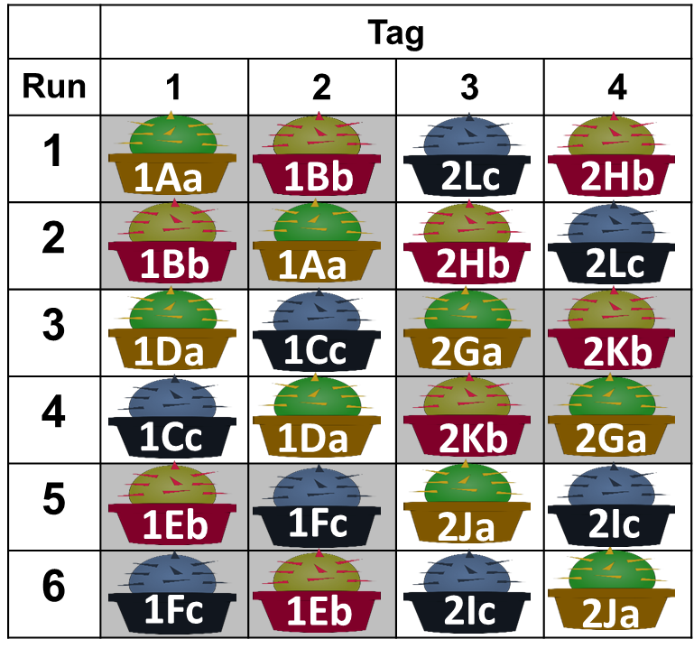
Optimal design: How well have we done?
Phase 1 ANOVA:
Phase 2 ANOVA:
Notes:
The theoretical ANOVA can be expressed as (again generated from the infoDecompuTE R package) .. Between Runs and Within Runs stratum ……
I have add the canonical efficiency factor in the last column of the table.
The treatment effects is confounded with Runs where two DF associated with treatment effects with 1/16 of treatment information. There is still 2 DF associated with treatment effects in the Between Plants Within Trays Within Runs stratum with 15/16 and 15/16 of treatment information, the average efficiency factor is calculated to be 6/7.
So for this design, the test of the treatment effects can still be conducted, there is still 2 DF of treatment in the Between Animals Within Runs stratum and the amount of treatment information is at its maximum.

Slide 18
Additional strategy
Maximise confounding of Phase 1 blocks with Tags
Notes:
Since we are not interest in the Block effects from the Phase 1 experiment,

Slide 19
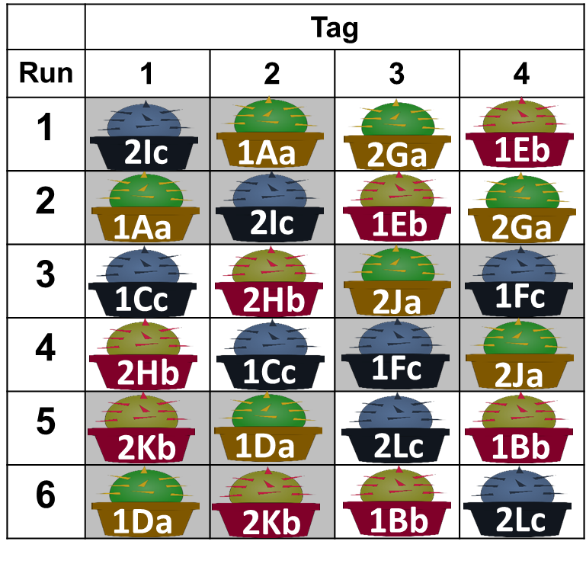
Additional strategy
Maximise confounding of Phase 1 blocks with Tags
Under the construction of the initial design. Only need to swap sub-samples within the same Tags to preserve this structure.
ANOVA of the optimal design
ANOVA of this design

Slide 20
Concluding remarks
Consider the computer generation of optimal designs of two-phase experiments, where the Phase 1 experiment arranged in a
completely randomised design (Chapter 3).
randomised complete block design, or a balanced incomplete block design (Chapter 4).
an application for generating these designs for the biologist
Automation of the construction of theoretical ANOVA tables
To compare the properties of designs.
R package infoDecompuTE (Chapter 2).

Slide 21
Acknowledgments
Dr. Kathy Ruggiero
Prof. Chris Triggs and Dr. Richard Jarrett
Colleagues from
Bioinformatic Institute,
Statistical Consulting Centre and
Centre of Methods and Policy Application in the Social Sciences

